Slide 1
HYPOTHESIS TESTS ABOUT THE MEAN AND PROPORTION

Slide 2

HYPOTHESIS TESTS
AN INTRODUCTION
A soft drink company claims that its cans of soft drinks , on an average, contain 12 ounces of soda.
How can the claim be verified?
  A first approach may be to collect all the cans of soft drink produced by the company, and determine the mean amount of soda in all the cans.
  A second approach could be to collect a sample of say 100 cans of the soft drink produced by the company, and determined the mean amount of soda in all the cans, for example to be 11.8 ounces.
Which of the approaches should we adopt?
  The first approach will yield the true mean amount of soda in all the cans. However, this approach would be unrealistic, un-achievable, and cost prohibitive.
  The second approach may or may not yield a true mean amount of soda in all cans. It is, however, manageable and produce a point estimate of the population mean amount of soda in all the cans. That is,

Slide 3
Hypotheses Test - Introduction
We are done with this chapter if we chose the first approach.
So let us examine the second approach further.
  Can we conclude that the mean amount of soda in all cans is 11.80 ounces, and that the company’s claim is false?
  Not so fast. If there is no nonsampling error, the difference between 11.80 and 12 ounces could have been due to the selected cans in the sample (chance)
  A different sample could have produced a mean amount of 12.04 ounces.
So what can we do to verify the company’s claim?
  We conduct hypothesis test to determine how large is the difference, for example, between 11.80 and 12.0 ounces, and
  Whether the difference is due to chance.
General Statement
A test of hypothesis is performed whenever a decision is made about a population based on the value of a sample statistic.

Slide 4
Two Hypotheses
Introduction
In conducting a hypothesis test for our example, we examine two statements:
  The company claim is true.
  The company claim is false.
These statements are examined under two hypotheses, null hypothesis, denoted by H₀ and alternative hypothesis, denoted by H₁.
Definitions
Null hypothesis is a claim or statement about a population parameter that is assumed to be true until it is proven to be false. In our example, null hypothesis is represented as,
Alternative hypothesis is a claim about a population parameter which will be true if the null hypothesis is false. In our example, alternative hypothesis is represented as,

Slide 5


Two Hypotheses
The information we obtained from a sample will be used to verify the company’s claim.
  That is, the information will confirm whether the null hypothesis, H₀, should be rejected and the alternative hypothesis, H₁, accepted, or
  The H₀ should not be rejected.
Two Types of Error
Like any decision, there is always a possibility of making a wrong decision. The two possible decisions from our example are:
  We do not reject H₀.
  We reject H₀, that is, H₁ is true.
There are, however, four possible outcomes from our example:
  We correctly do not reject H₀. (company’s claim is true).
  We correctly rejected H₀ and accepted H₁. (company’s claim is false).
  We rejected H₀ when we should have not rejected it.
  We do not reject H₀ when we should have rejected it
The types of errors in (3) and (4) are called Type I or errors
and Type II or errors, respectively.

Slide 6


Two Type of Error
Definitions
Type I or error occurs when a true null hypothesis is rejected.
  The value of is the probability of committing Type I error, and is denoted as,
  also represents the significance level of the test.
  The size of the rejection region depends on
  can be assigned any value, but usually the value does not exceed 0.10.
  Common values for are 0.01, 0.025, 0.05, and 0.10.
Type II or error occurs when a false hypothesis is not rejected.
  The value of is the probability of committing this error, and is denoted as,
  The value of is called power of the test and represents the probability of not making a Type II error.

Slide 7
Two Type of Error
The four possible outcomes of our example are represented in Table 1 below.
 |  | Actual Solution
 |  | H₀: Is true | H₀: False
Our Decision | H₀: Do not reject | Correct | Type II error
 | H₀: Reject | Type I error | Correct
General Statement
and depend on each other. That is an increase/decrease of one will result in a decrease/increase of the other for a fixed sample size
Increase in sample size will simultaneously decrease both and .

Slide 8

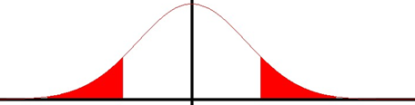

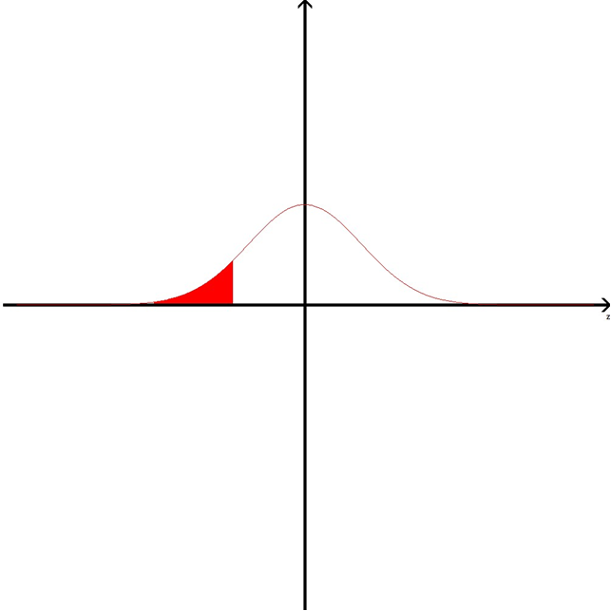

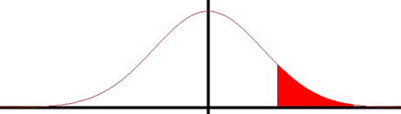
Tails of a Test
The outcomes of every test of hypothesis are classified into a rejection region or nonrejection region.
The partition of the total region depends on the value of
The rejection region can be on:
  Both sides of the nonrejection region (two-tailed test).
  The left side of the nonrejection region (left-tailed test).
  The right side of the nonrejection region (right-tailed test)
The type of tail test is based on the sign contained in H₁.
  signifies two-tailed test.
  “<“ signifies left-tailed test.
  “>” signifies right-tailed test.
Rejection region
nonrejection region
Rejection region
Two-tailed Test
Left-tailed Test
Right-tailed Test
Rejection region
nonrejection region
Rejection region
nonrejection region

Slide 9
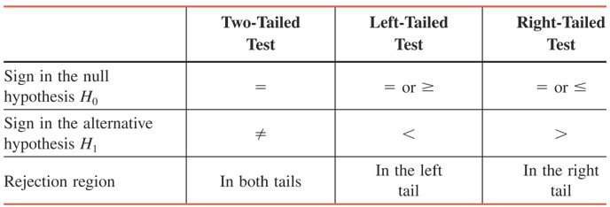
Signs in H₀ and H₁ and Tails of a Test

Slide 10



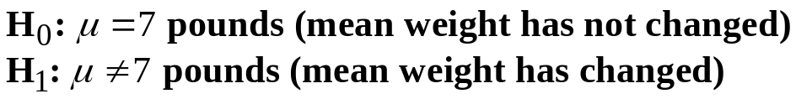
Tails of a Test – A two-tailed test
Definition
A two-tailed test of hypothesis has two rejection regions, one in each tail of the distribution curve and a nonrejection region in the middle.
Issue
In 1980, a sample survey of 3000 newly born children in U.S. was conducted to determine their mean weight. The survey showed that the mean weight was 7 pounds. A group of STA120 students has decided to verify whether the mean weight of newly born children has changed since 1980.
Analysis
Let = the mean weight of the newly born children in U.S. since 1980. That is,
The two possible decisions from this analyzes are:
  The mean weight of the children has not changed. That is,
  The mean weight of the children has changed. That is,
So, the null and alternative hypotheses can be written as,

Slide 11





Tails of a Test – A two-tailed test
Analysis
This test is two-tailed because H₁ contains
The figure to the right shows the sampling distribution of assuming that it is normally distributed.
The figure also assumes that H₀ is true and the mean weight is equal to 7 pounds.
The area in each tail under the curve is
The sum of the areas is
As shown in the figure, a two-tailed test has two critical values, C₁ and C₂, which separate the rejection regions from nonrejection region
Decision
Rejection region
Rejection region
nonrejection region
z
C₁
C₂
  Reject H₀ if the value of falls within one of the rejection regions.
  is too large to have been caused only be sampling errors.
  Do not reject H₀ if the value of falls within the nonrejection region.
  is too small to assume that the difference is caused by sampling errors.

Slide 12


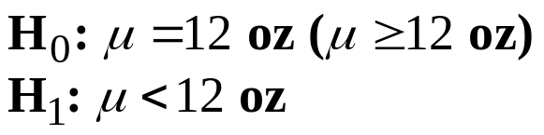
Tails of a Test – A left-tailed test
Definition
A left-tailed test applies when the rejection region is to the left of the nonrejection region.
Issue
In the case of the company claiming that its cans of soft drinks, on an average, contain 12 ounces of soda.
Analysis
The two possible decisions from this analyzes are:
  The mean amount of soda in the cans of soft drinks is equal to 12 ounces. That is,
  The mean amount of soda in the cans of soft drinks is less than 12 ounces. That is,
Then, the null and alternative hypotheses can be written as,
Since the sign in H₁ is “<“, this test is left-tailed.

Slide 13

Tails of a Test – A left-tailed test
Analysis
The figure below shows the sampling distribution of assuming that it is normally distributed.
The figure also assumes that H₀ is true and the sampling distribution has a mean of 12 ounces.
The area in the left tail under the curve is
As shown below, a left-tailed test has one critical values, C₁, which separate the rejection region from nonrejection region.
Decision
  Reject H₀ if the value of falls within the rejection region.
  is too large to have been caused only be sampling errors.
  Do not reject H₀ if the value of falls within the nonrejection region.
  is too small to assume that the difference is caused by sampling errors.
Rejection region
nonrejection region
z
C₁

Slide 14


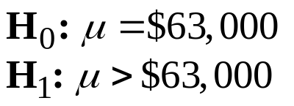
Tails of a Test – A right-tailed test
Definition
A right-tailed test applies when the rejection region is to the right of the nonrejection region.
Issue
In 2002, the average income of entry level engineers is $63,000. Suppose we want to verify whether the current mean income of entry level engineers is greater than $63,000.
Analysis
The two possible decisions from the test of hypothesis are:
  The mean income of entry level engineers is not higher than $63,000. That is,
  The mean income of entry level engineers is higher than $63,000. That is,
Then, the null and alternative hypotheses can be written as,
Since the sign in H₁ is “>“, this test is right-tailed.

Slide 15

Tails of a Test – A right-tailed test
Analysis
The figure below shows the sampling distribution of assuming that it is normally distributed.
The figure also assumes that H₀ is true and the sampling distribution has a mean of $63,000.
The area in the right tail under the curve is
As shown below, a right-tailed test has one critical values, C₁, which separate the rejection region from the nonrejection region.
Decision
  Reject H₀ if the value of falls within the rejection region.
  is too large to have been caused only be sampling errors.
  Do not reject H₀ if the value of falls within the nonrejection region.
  is too small to assume that the difference is caused by sampling errors.
Rejection region
nonrejection region
z
C₁

Slide 16
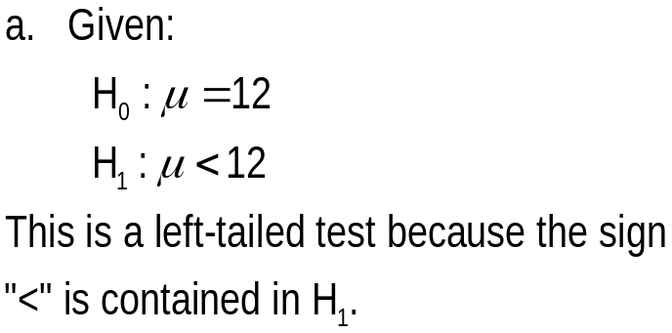
Hypothesis Tests - Introduction
Example #1
Explain which of the following is a two-tailed test, a left-tailed test, or a right-tailed test.
Show the rejection and nonrejection regions for each of these cases by drawing a sampling distribution curve for the sample mean, assuming that it is normally distributed
Example #1 – Solution
Rejection region
nonrejection region
z
C₁

Slide 17
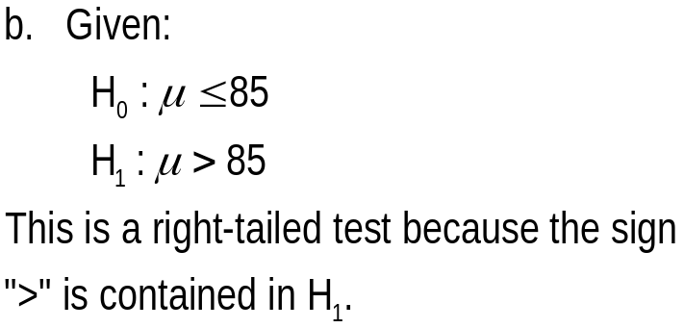

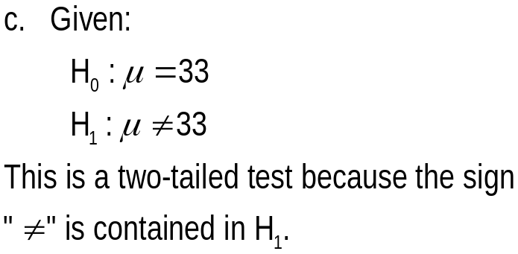

Hypothesis Tests - Introduction
Example #1 – Solution
Rejection region
nonrejection region
z
C₁
Rejection region
Rejection region
nonrejection region
z
C₁
C₂

Slide 18
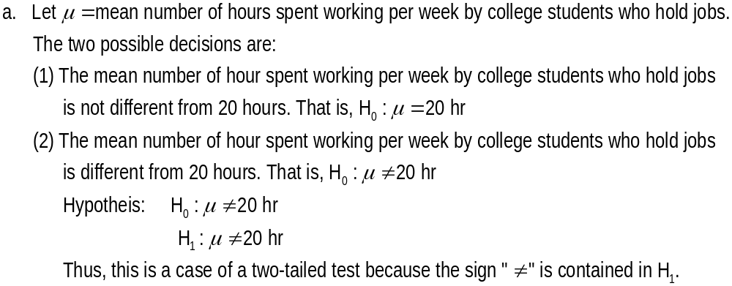
Hypothesis Tests - Introduction
Example #2
Write the null and alternative hypotheses for each of the following examples. Determine if each is a case of a two-tailed test, a left-tailed test, or a right-tailed test.
To test if the mean number of hours spent working per week by college students who hold jobs is different from 20 hours.
To test whether or not a bank’s ATM is out of service for an average of more than 10 hours per month.
Example #2 – Solution

Slide 19
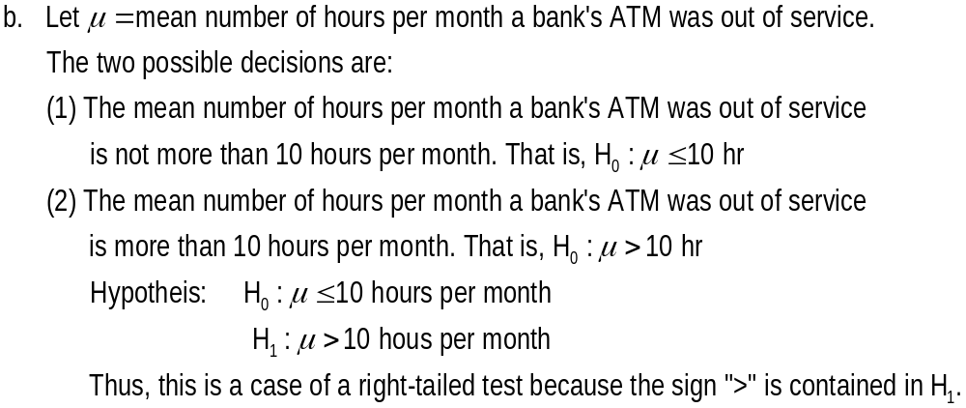
Hypothesis Tests - Introduction
Example #2
Write the null and alternative hypotheses for each of the following examples. Determine if each is a case of a two-tailed test, a left-tailed test, or a right-tailed test.
To test whether or not a bank’s ATM is out of service for an average of more than 10 hours per month.
Example #2 – Solution

Slide 20
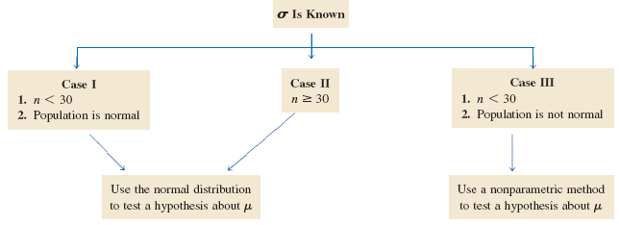
HYPOTHESIS TESTS ABOUT μ: σ KNOWN
Three Possible Cases

Slide 21




HYPOTHESIS TESTS ABOUT μ: σ KNOWN
There are two techniques for performing the tests of hypothesis about These techniques are the:
  p-Value approach
  Critical-Value approach
The p-Value Approach
The p-value approach determines a probability value such that the null hypothesis, H₀, is:
  Rejected for any greater than the value.
  Not rejected for any less than the value.
Thus, p-value is the smallest significance value at which the null hypothesis, H₀, is rejected.
If is unknown, the p-value is used to make/state a decision.
If is known, the p-value is compared to the and a decision is made.
Our decision could be:
  Reject H₀ if
  Do not reject H₀ if

Slide 22


The p–value for a left-tailed, two-tailed and right-tailed tests
The sum of these two areas gives the p-value
p-value
Value of observed from the sample
Value of observed from the sample
p-value
Value of observed from the sample

Slide 23
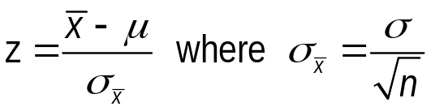
The p-value Approach
To find the p-value, we first have to find the z-value for by using the formula,
The calculated z-value is also called the observed value of z
We can find the area in the tail of the curve beyond the value of z by using the standard normal distribution table. This area is the p-value (one-tailed) or ½ of the p-value (2-tailed).
Steps for a test of hypothesis using the p-Value Approach
  State the null and alternative hypothesis
  Select the distribution to use (z or t distribution)
  Calculate the p-value
  Make a decision

Slide 24

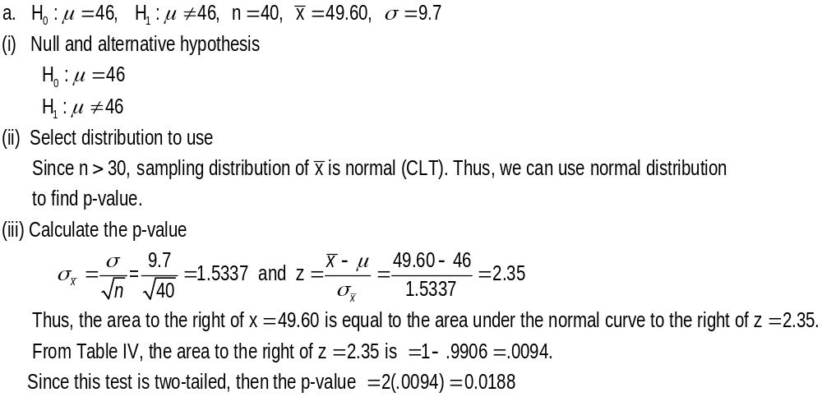



The p-value Approach
Example #3
Find the p-value for each of the following hypothesis tests.
Example #3 – Solution
2.35
z
-2.35

Slide 25
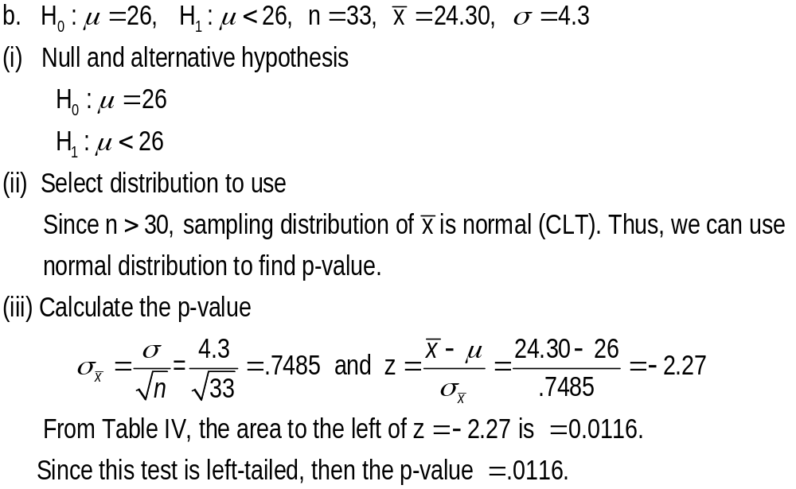


The p-value Approach
Example #3
Find the p-value for each of the following hypothesis tests.
Example #3 – Solution
-2.27
z

Slide 26
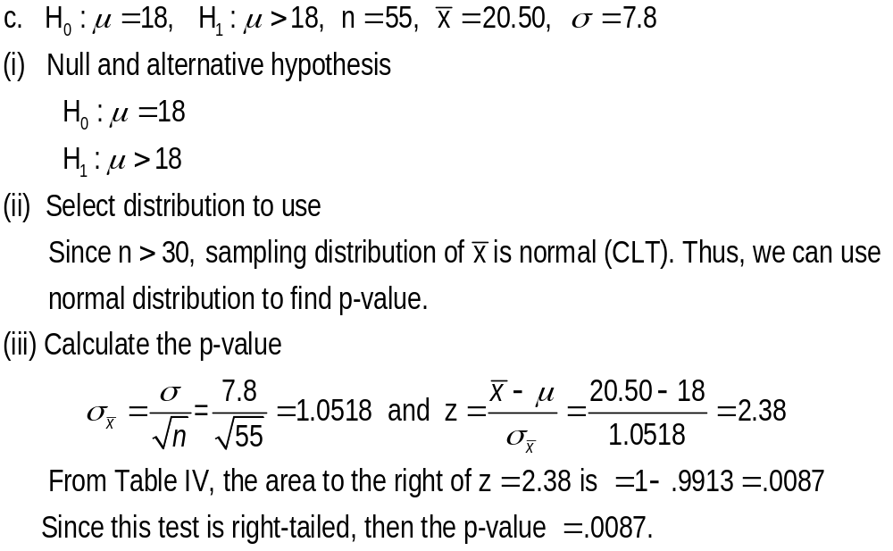



The p-value Approach
Example #3
Find the p-value for each of the following hypothesis tests.
Example #3 – Solution
2.38
z

Slide 27


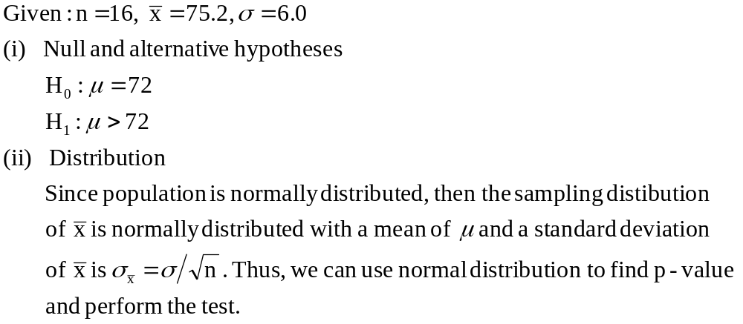
The p-value Approach
Example #4
Consider A random sample of 16 observations taken from this population produced a sample mean of 75.2. The population is normally distributed with
a) Calculate p-value.
Example #4 – Solution

Slide 28

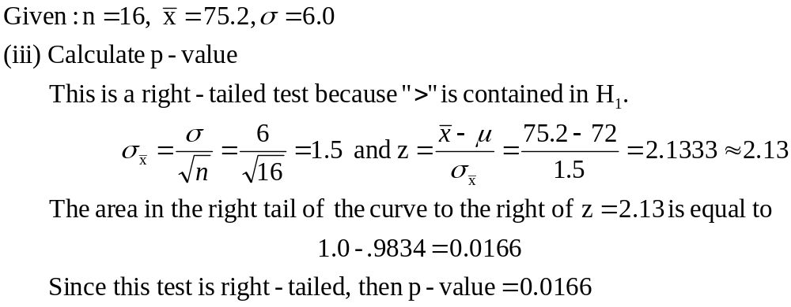


The p-value Approach
Example #4
Consider A random sample of 16 observations taken from this population produced a sample mean of 75.2. The population is normally distributed with
a) Calculate p-value.
Example #4 – Solution
2.13
z

Slide 29
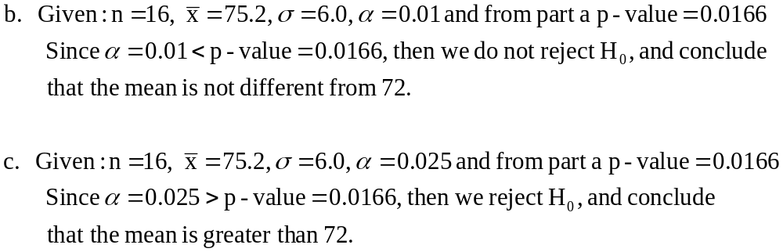
The p-value Approach
Example #4
Consider A random sample of 16 observations taken from this population produced a sample mean of 75.2. The population is normally distributed with
b) Considering the p-value of part a, would you reject the null hypothesis if the
test were made at the significance level of .01?
c) Considering the p-value of part a, would you reject the null hypothesis if the
test were made at the significance level of .025?
Example #4 – Solution

Slide 30

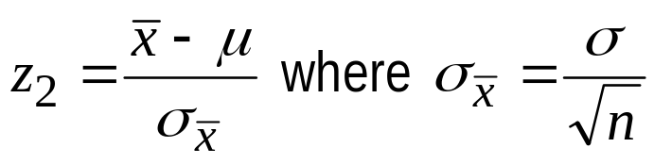
HYPOTHESIS TESTS ABOUT μ: σ KNOWN
The Critical-Value Approach
The critical-value approach is also called a classical or traditional approach.
This approach relies on a predetermined significance level, which represents the rejection region under the normal distribution curve.
It involves:
  Finding the critical value of the test statistic, z₁, based on a given significance level .
  Calculating the value of the test statistic, z₂, for the observed value of sample statistic, .
  Compare (1) and (2) and make decision as follows:
    For left-tailed test, reject H₀ if z₁ > z₂ in (2) and do not reject H₀ if
    z₁ < z in (2),
    For right-tailed test, reject H₀ if z₁ < z₂ , and do not reject H₀ if
    z₁ > z₂ , and
    For two-tailed test, reject H₀ if z₂ is not between the z₁’s and do not reject H₀ if z₂ is between the z₁’s.

Slide 31


The Critical-Value Approach
Steps for a test of hypothesis using the critical-Value Approach
  State the null and alternative hypothesis
  Select the distribution to use (z or t distribution)
  Determine rejection and nonrejection regions
  Calculate the value of test statistic, z-value
  Make a decision
General Statements
  Some authors used the phrase “statistically significantly different” or “statistically not significantly different” to make conclusion on hypothesis test.
  The phrase “statistically significantly different” means that the difference between the observed value of and the hypothesized value of the is so large that it is not could not only be caused by sampling errors. A such the null hypothesis is rejected.
  The phrase “statistically not significantly different” means that the difference between is so small that it may have occurred only because of sampling error. A such the null hypothesis is not rejected.

Slide 32
Example
The TIV Telephone Company provides long-distance telephone service in an area. According to the company’s records, the average length of all long-distance calls placed through this company in 2009 was 12.44 minutes. The company’s management wanted to check if the mean length of the current long-distance calls is different from 12.44 minutes. A sample of 150 such calls placed through this company produced a mean length of 13.71 minutes with a standard deviation of 2.65 minutes. Using the 2% significance level, can you conclude that the mean length of all current long-distance calls is different from 12.44 minutes?

Slide 33
Solution
Step 1: H₀ : μ = 12.44 H₁ : μ ≠ 12.44
Step 2: The population standard deviation σ is known, and the sample size is large (more than 30). Due to the Central Limit Theorem, we will use the normal distribution to perform the test.

Slide 34
Solution
Step 3: α = .02
The ≠ sign in the alternative hypothesis indicates that the test is two-tailed
Area in each tail = α / 2= .02 / 2 = .01
The z values for the two critical points are -2.33 and 2.33

Slide 35
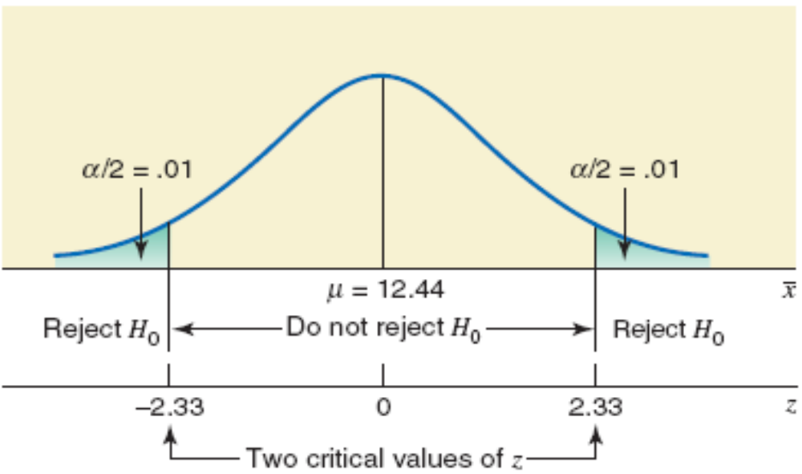
Figure

Slide 36
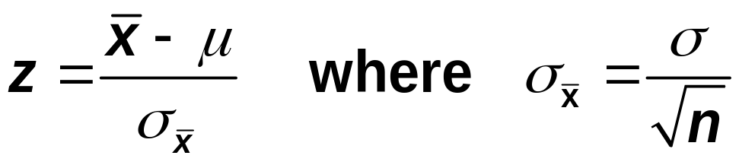
Calculating the Value of the Test Statistic
When using the normal distribution, the value of the test statistic z for x for a test of hypothesis about μ is computed as follows:
The value of z for x is also called the observed value of z.

Slide 37
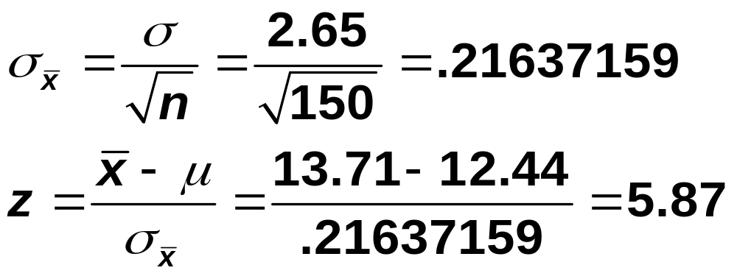
Solution
Step 4:

Slide 38
Solution
Step 5: This value of z = 5.87 is greater than the critical value of z = 2.33, and it falls in the rejection region in the right tail in Figure 9.9. Hence, we reject H₀ and conclude that based on the sample information, it appears that the mean length of all such calls is not equal to 12.44 minutes.

Slide 39
Example
The mayor of a large city claims that the average net worth of families living in this city is at least $300,000. A random sample of 25 families selected from this city produced a mean net worth of $288,000. Assume that the net worths of all families in this city have a normal distribution with the population standard deviation of $80,000. Using the 2.5% significance level, can you conclude that the mayor’s claim is false?

Slide 40
Solution
Step 1: H₀ : μ ≥ $300,000
H₁ : μ < $300,000
Step 2: The population standard deviation σ is known, the sample size is small (n < 30), but the population distribution is normal. Consequently, we will use the normal distribution to perform the test.

Slide 41
Solution
Step 3: α = .025
The < sign in the alternative hypothesis indicates that the test is left-tailed
Area in the left tail = α = .025
The critical value of z is -1.96

Slide 42
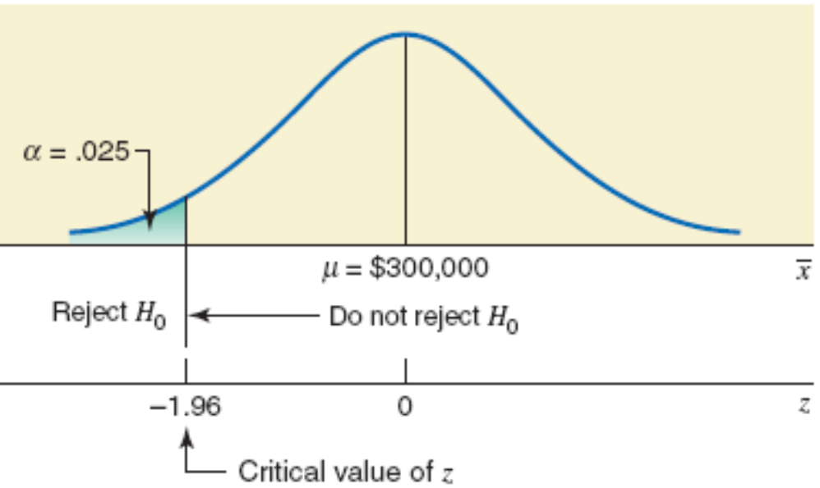
Figure

Slide 43
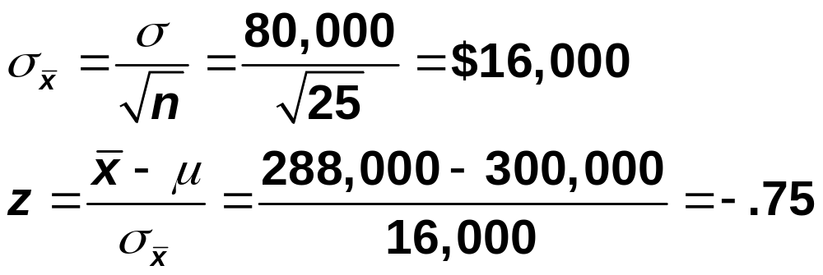
Solution
Step 4:

Slide 44
Solution
Step 5: This value of z = -.75 is greater than the critical value of z = -1.96, and it falls in the nonrejection region. As a result, we fail to reject H₀. Therefore, we can state that based on the sample information, it appears that the mean net worth of families in this city is not less than $300,000.

Slide 45
HYPOTHESIS TESTS ABOUT μ: σ NOT KNOWN
Three Possible Cases
Case I. If the following three conditions are fulfilled:
1. The population standard deviation σ is not known
2. The sample size is small (i.e., n < 30)
3. The population from which the sample is selected is normally distributed.

Slide 46
HYPOTHESIS TESTS ABOUT μ: σ NOT KNOWN
Three Possible Cases
Case II. If the following two conditions are fulfilled:
1. The population standard deviation σ is not known
2. The sample size is large (i.e., n ≥ 30)

Slide 47
HYPOTHESIS TESTS ABOUT μ: σ NOT KNOWN
Three Possible Cases
Case III. If the following three conditions are fulfilled:
1. The population standard deviation σ is not known
2. The sample size is small (i.e., n < 30)
3. The population from which the sample is selected is not normally distributed (or its distribution is unknown).

Slide 48
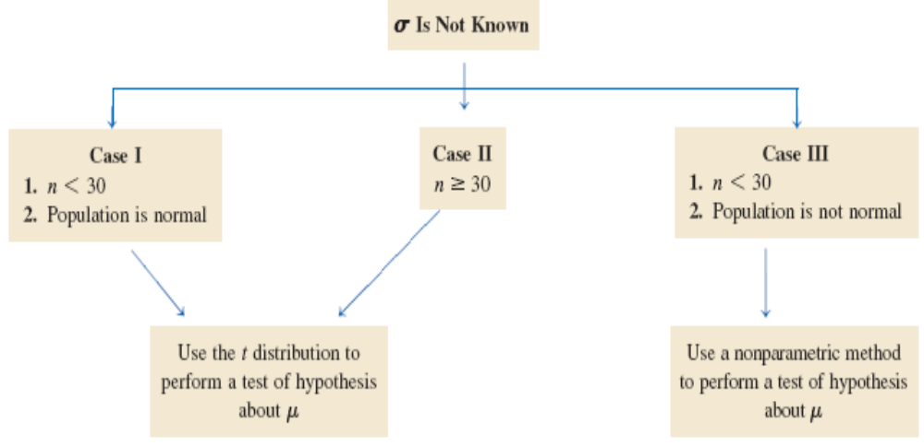
HYPOTHESIS TESTS ABOUT μ: σ NOT KNOWN
Three Possible Cases

Slide 49
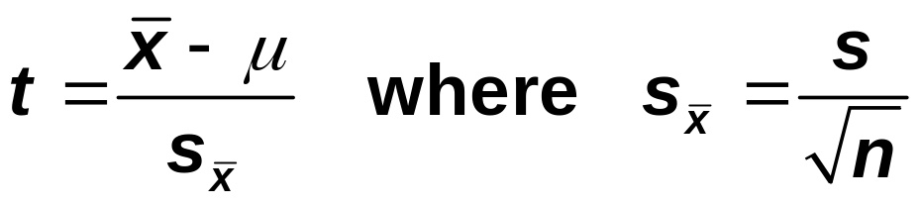
HYPOTHESIS TESTS ABOUT μ: σ NOT KNOWN
Test Statistic
The value of the test statistic t for the sample mean x is computed as
The value of t calculated for x by using this formula is also called the observed value of t.

Slide 50
Example
A psychologist claims that the mean age at which children start walking is 12.5 months. Carol wanted to check if this claim is true. She took a random sample of 18 children and found that the mean age at which these children started walking was 12.9 months with a standard deviation of .80 month. It is known that the ages at which all children start walking are approximately normal distributed. Find the p-value for the test that the mean age at which all children start walking is different from 12.5 months. What will your conclusion be if the significance level is 1%?

Slide 51
Solution
Step 1: H₀ : μ = 12.5
H₁ : μ ≠ 12.5
Step 2: The population standard deviation σ is not known, the sample size is small (n < 30), and the population is normally distributed. Consequently, we will use the t distribution to find the p-value for the test.

Slide 52
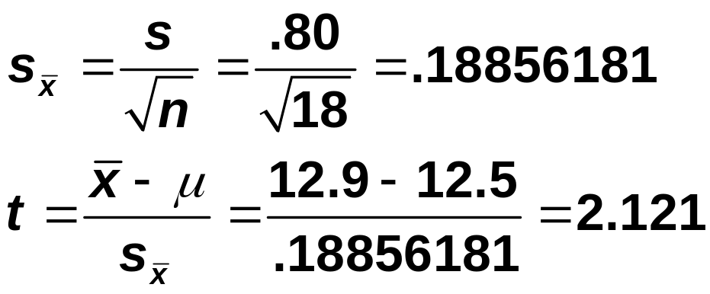
Solution
Step 3: The ≠ sign in the alternative hypothesis indicates that the test is two-tailed
and df = n – 1 = 18 – 1 = 17
.02 < p-value < .05

Slide 53
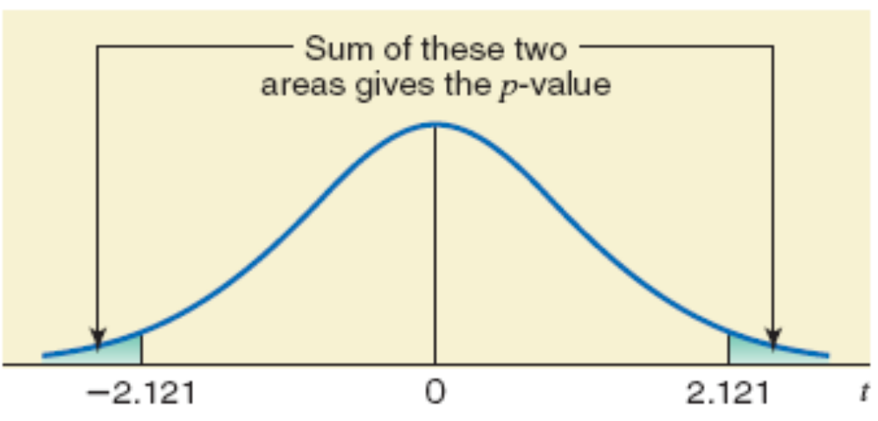
Figure: The required p-value

Slide 54
Solution
Step 4: For any α greater than .05, we will reject the null hypothesis. For any α less than .02, we will not reject the null hypothesis. For our example, α = .01, which is less than the lower limit of the p-value ranges of .02. As a result, we fail to reject H₀ and conclude that the mean age at which all children start walking is not different from 12.5 months.

Slide 55
Example
Grand Auto Corporation produces auto batteries. The company claims that its top-of-the-line Never Die batteries are good, on average, for at least 65 months. A consumer protection agency tested 45 such batteries to check this claim. It found the mean life of these 45 batteries to be 63.4 months with a standard deviation of 3 months. Find the p-value for the test that mean life of all such batteries is less than 65 months. What will your conclusion be if the significance level is 2.5%?

Slide 56
Solution
Step 1: H₀ : μ ≥ 65
H₁ : μ < 65
Step 2: The population standard deviation σ is not known and the sample size is large (n > 30). Consequently, we will use the t distribution to find the p-value for the test.

Slide 57
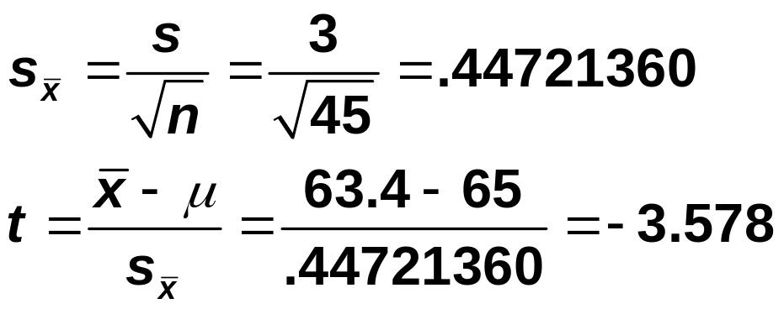
Solution
Step 3: The < sign in the alternative hypothesis indicates that the test is left-tailed
and df = n – 1 = 45 – 1 = 44
p-value < .001

Slide 58
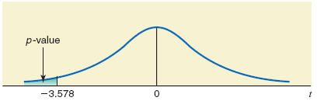
Figure: The required p-value

Slide 59
Example
Refer to Example 9-5. A psychologist claims that the mean age at which children start walking is 12.5 months. Carol wanted to check if this claim is true. She took a random sample of 18 children and found that the mean age at which these children started walking was 12.9 months with a standard deviation of .80 month. Using the 1% significance level, can you conclude that the mean age at which all children start walking is different from 12.5 months? Assume that the ages at which all children start walking have an approximately normal distribution.

Slide 60
Solution
Step 1: H₀ : μ = 12.5
H₁ : μ ≠ 12.5
Step 2: The population standard deviation σ is not known, the sample size is small (n < 30), and the population is normally distributed. Consequently, we will use the t distribution to perform the test.

Slide 61
Solution
Step 3: Significance level = .01. The ≠ sign in the alternative hypothesis indicates that the test is two-tailed and the rejection region lies in both tails.
Area in each tail = α/2 = .01/2 = .005
df = n – 1 = 18 – 1 = 17
The critical values for t for 17 df and .005 area in each tail are -2.898 and 2.898.

Slide 62
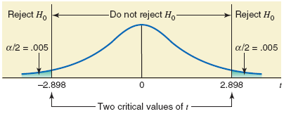
Figure: The required p-value

Slide 63
Solution
Step 4:
The value of the test statistic t = 2.121 falls between the two critical points, -2.898 and 2.898, which is the nonrejection region. Consequently, we fail to reject H0. As a result, we can state the difference between the hypothesized population mean and the sample mean is so small that it may have occurred because of sampling error.

Slide 64
Example
The management at Massachusetts Savings Bank is always concerned about the quality of service provided to its customers. With the old computer system, a teller at this bank could serve, on average, 22 customers per hour. The management noticed that with this service rate, the waiting time for customers was too long. Recently the management of the bank installed a new computer system in the bank, expecting that it would increase the service rate and consequently make the customers happier by reducing the waiting time.

Slide 65
Example
To check if the new computer system is more efficient than the old system, the management of the bank took a random sample of 70 hours and found that during these hours the mean number of customers served by tellers was 27 per hour with a standard deviation of 2.5. Testing at the 1% significance level, would you conclude that the new computer system is more efficient than the old computer system?

Slide 66
Solution
Step 1: H₀ : μ = 22
H₁ : μ > 22
Step 2: The population standard deviation σ is not known and the sample size is large (n > 30). Consequently, we will use the t distribution to perform the test.

Slide 67
Solution
Step 3: Significance level = .01. The > sign in the alternative hypothesis indicates that the test is right-tailed and the rejection region lies in the right tail.
Area in the right tail = α = .01
df = n – 1 = 70 – 1 = 69
The critical value for t for 69 df and .01 area in the right tail is 2.382.

Slide 68
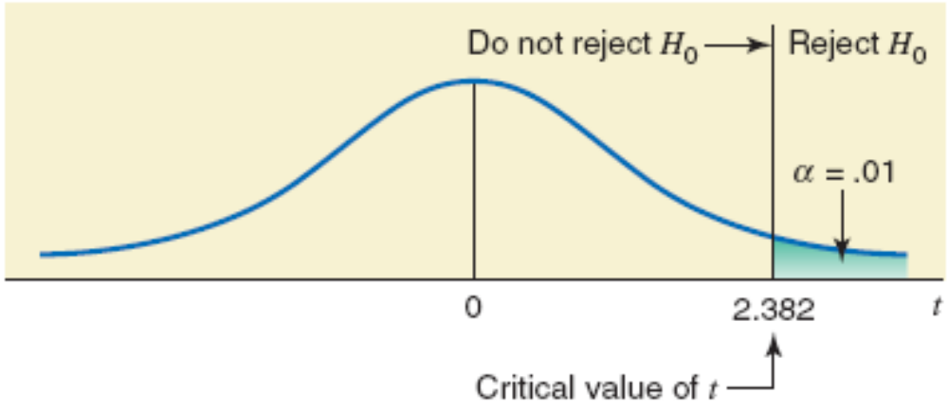
Figure

Slide 69
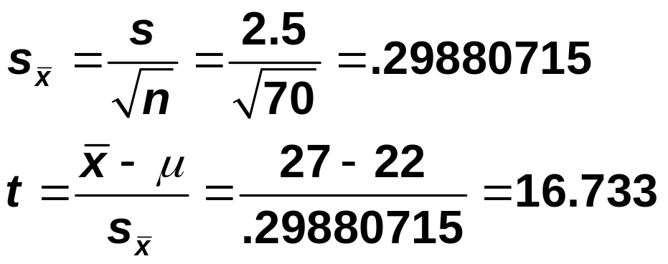
Solution
Step 4:
The value of the test statistic t = 16.733 is greater than the critical value of t = 2.382, and it falls in the rejection region. Consequently, we reject H0. As a result, we conclude that the value of the sample mean is too large compared to the hypothesized value of the population mean, and the difference between the two may not be attributed to chance alone.

Slide 70
Tests of Hypothesis for μ Using the t Distribution
What If the Sample Size Is Too Large?
1. Use the t value from the last row (the row of ∞) of Appendix A-3.
2. Use the normal distribution as an approximation to the t distribution.

Slide 71

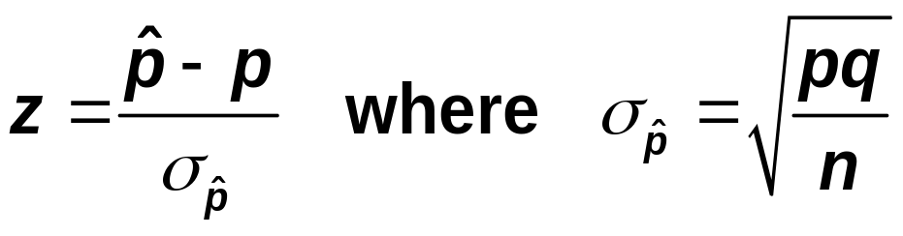
HYPOTHESIS TESTS ABOUT A POPULATION PROPORTION: LARGE SAMPLES
Test Statistic
The value of the test statistic z for the sample proportion, , is computes as
The value of p that is used in this formula is the one from the null hypothesis. The value of q is equal to 1-p. The value of z calculated for using the above formula is also called the observed value of z.

Slide 72
Example
According to a Nationwide Mutual Insurance Company Driving While Distracted Survey conducted in 2008, 81% of the drivers interviewed said that they have talked on their cell phones while driving (The New York Times, July 19, 2009). The survey included drivers aged 16 to 61 years selected from 48 states. Assume that this result holds true for the 2008 population of all such drivers in the United States. In a recent random sample of 1600 drivers aged 16 to 61 years selected from the United States, 83% said that they have talked on their cell phones while driving.

Slide 73
Example
Find the p-value to test the hypothesis that the current percentage of such drivers who have talked on their cell phones while driving is different from 81%. What is your conclusion if the significance level is 5%?

Slide 74
Solution
Step 1: H₀ : p = .81
H₁ : p ≠ .81
Step 2: To check whether the sample is large, we calculate the values of np and nq:
np = 1600(.81) = 1296 > 5
nq = 1600(.19) = 304 > 5
Consequently, we will use the normal distribution to find the p-value for this test.

Slide 75
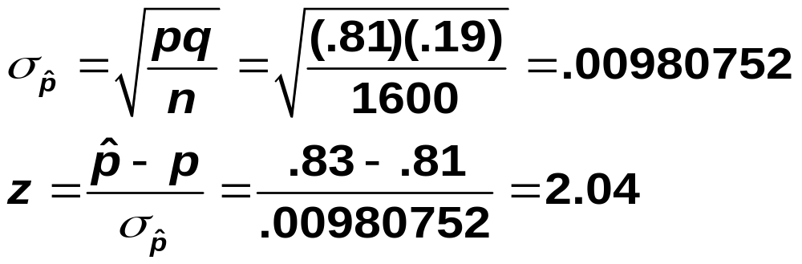
Solution
Step 3: The ≠ sign in the alternative hypothesis indicates that the test is two-tailed.
p-value = 2(.0207) = .0414

Slide 76
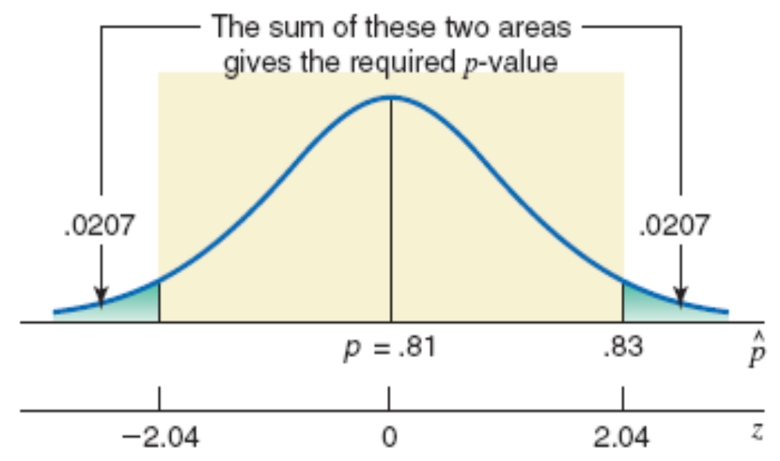
Figure: The required p-value

Slide 77
Solution
Step 4: We can state that for any α greater than .0414 we will reject the null hypothesis. For our example, α = .05, which is greater than the p-value of .0414. As a result, we reject H₀ and conclude that the current percentage of all U.S. drivers aged 16 to 61 years who have talked on their cell phones while driving is different from .81.

Slide 78
Example
When working properly, a machine that is used to make chips for calculators does not produce more than 4% defective chips. Whenever the machine produces more than 4% defective chips, it needs an adjustment. To check if the machine is working properly, the quality control department at the company often takes samples of chips and inspects them to determine if they are good or defective.

Slide 79
Example
One such random sample of 200 chips taken recently from the production line contained 12 defective chips. Find the p-value to test the hypothesis whether or not the machine needs an adjustment. What would your conclusion be if the significance level is 2.5%?

Slide 80
Solution
Step 1: H₀: p ≤ .04
H₁: p > .04
Step 2: To check whether the sample is large, we calculate the values of np and nq:
np = 200(.04) = 8 > 5
nq = 200(.96) = 192 > 5
Consequently, we will use the normal distribution to find the p-value for this test.

Slide 81
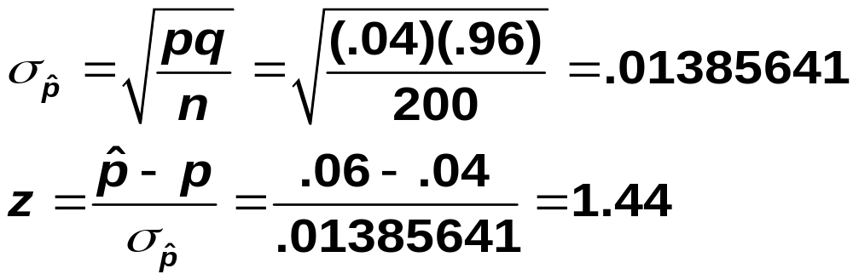
Solution
Step 3: The > sign in the alternative hypothesis indicates that the test is right-tailed.
p-value = .0749

Slide 82
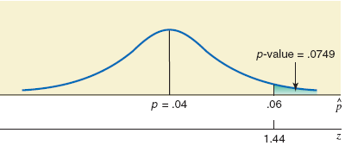
Figure: The required p-value

Slide 83
Solution
Step 4: We can state that for any α greater than .0749 we will reject the null hypothesis, and for any α less than or equal to .0749 we will not reject the null hypothesis. For our example, α = .025, which is less than the p-value of .0749. As a result, we fail to reject H₀ and conclude that the machine does not need an adjustment.

Slide 84
Example
According to a Nationwide Mutual Insurance Company Driving While Distracted Survey conducted in 2008, 81% of the drivers interviewed said that they have talked on their cell phones while driving (The New York Times, July 19, 2009). The survey included drivers aged 16 to 61 years selected from 48 states. Assume that this result holds true for the 2008 population of all such drivers in the United States. In a recent random sample of 1600 drivers aged 16 to 61 years selected from the United States, 83% said that they have talked on their cell phones while driving.

Slide 85
Example
Using the 5% significance level, can you conclude that the current percentage of such drivers who have talked on their cell phones while driving is different from 81%.

Slide 86
Solution
Step 1: H₀ : p = .81
H₁ : p ≠ .81
Step 2: To check whether the sample is large, we calculate the values of np and nq:
np = 1600(.81) = 1296 > 5
nq = 1600(.19) = 304 > 5
Consequently, we will use the normal distribution to make the test.

Slide 87
Solution
Step 3: The ≠ sign in the alternative hypothesis indicates that the test is two-tailed. The significance level is .05. Therefore, the total area of the two rejection regions is .05.
Area in each tail = α / 2 = .05 / 2 = .025
The critical values of z are -1.96 and 1.96.

Slide 88
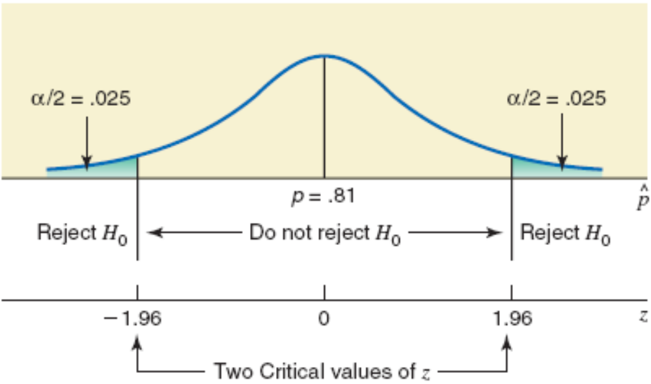
Figure: The critical values of z

Slide 89
Solution
Step 4:

Slide 90
Solution
Step 5: the value of test statistic z = 2.04 falls in the rejection region. As a result, we reject H0 and conclude that the current percentage of all U.S. drivers aged 16 to 61 years who have talked on their cell phones while driving is different from .81.

Slide 91
Example
Direct Mailing Company sells computers and computer parts by mail. The company claims that at least 90% of all orders are mailed within 72 hours after they are received. The quality control department at the company often takes samples to check if this claim is valid. A recently taken sample of 150 orders showed that 129 of them were mailed within 72 hours. Do you think the company’s claim is true? Use a 2.5% significance level.

Slide 92
Solution
Step 1: H₀ : p ≥ .90
H₁ : p < .90
Step 2: To check whether the sample is large, we calculate the values of np and nq:
np = 150(.90) = 135 > 5
nq = 150(.10) = 15 > 5
Consequently, we will use the normal distribution to make the test.

Slide 93
Solution
Step 3: Significance level = .025. The < sign in the alternative hypothesis indicates that the test is left-tailed, and the rejection region leis in the left tail.
The critical values of z for .0250 area in the left tail is -1.96.

Slide 94
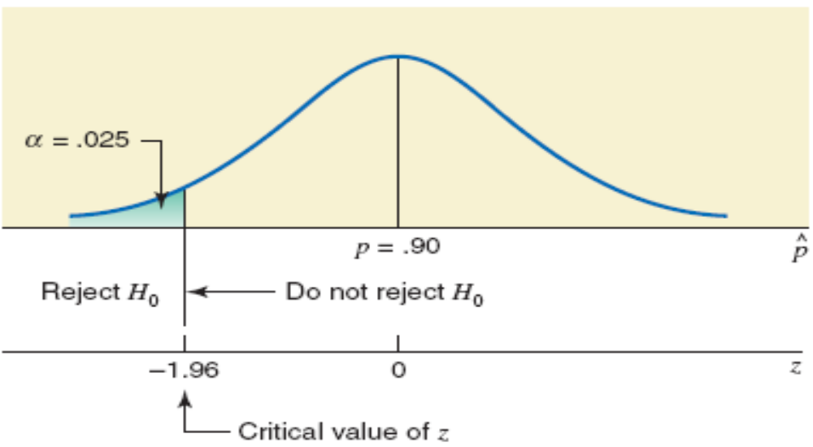
Figure: The critical values of z

Slide 95
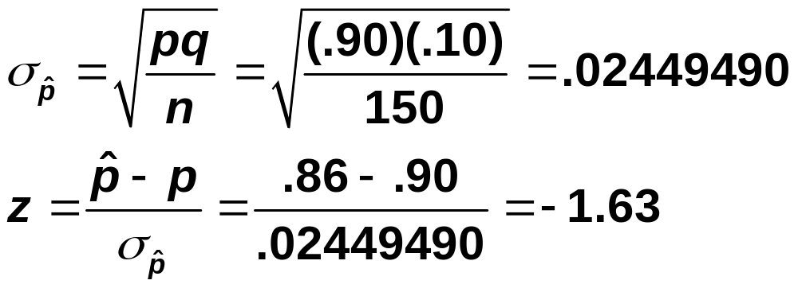
Solution
Step 4:

Slide 96
Solution
Step 5: The value of test statistic z = -1.63 is greater than the critical value of z = -1.96, and it falls in the nonrejection region. Therefore, we fail to reject H₀. We can state that the difference between the sample proportion and the hypothesized value of the population proportion is small, and this difference may have occurred owing to the chance alone.

